Slide 1

Fly on-time by Booking Smart
Exploratory Analysis by Medha Arora

Slide 2

Problem:
Flight delays are common but wouldn’t it be nice to have some way of predicting or foreseeing them to be able to avoid or be prepared for them?
Flight delays affect passengers travelling with kids or senior citizens the most. It would be helpful if the travel agencies could warn against possible flight delays for such passengers to keep them prepared or to help them make changes to their itinerary.
Every airline would also benefit from having details about flight delay patterns, to be able to manage them efficiently.

Slide 3

Explore Trends
It is a known fact that weather causes most flight delays. But there can be patterns related to time period, airlines and source and destination airports of a flight as well.
We will utilize the data available from the website of RITA which coordinates the U.S. Department of Transportation research efforts and explore the data to find trends of Arrival delays for flights across Months, across days of the week, across days of the Month, across airports (origin, destination and distances covered by flight paths) and across airlines.

Slide 4
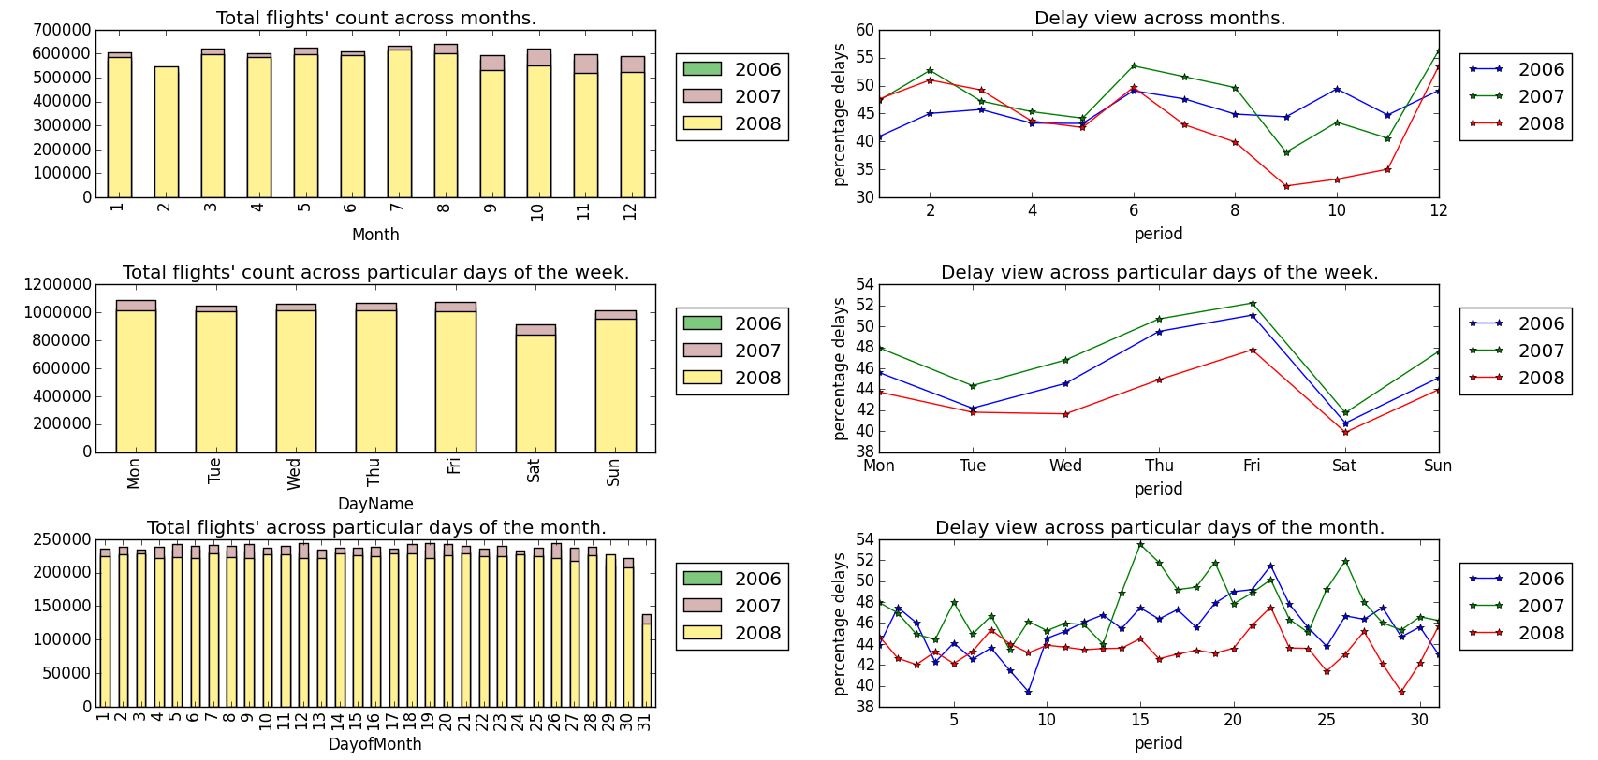
Period-based
We can see distinct peaks for February, June - August and December. Also, most delays occur right before the weekend (Thrusday - Friday) and towards month-ends (15th to 27th).

Slide 5
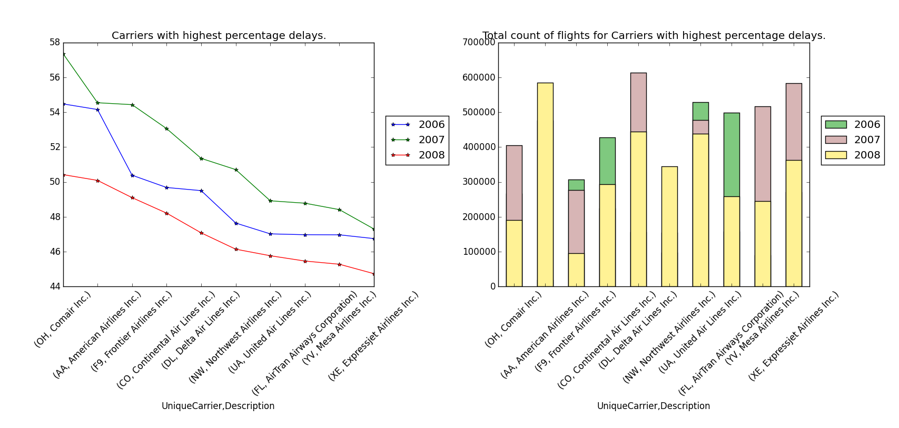
Airline based
Some airlines/carriers see more rate of delays. Even though all the above have the top 10 percentage delays, among the most prominent ones, we can see that United Air Lines have a much better rate o delays than American Airlines.

Slide 6
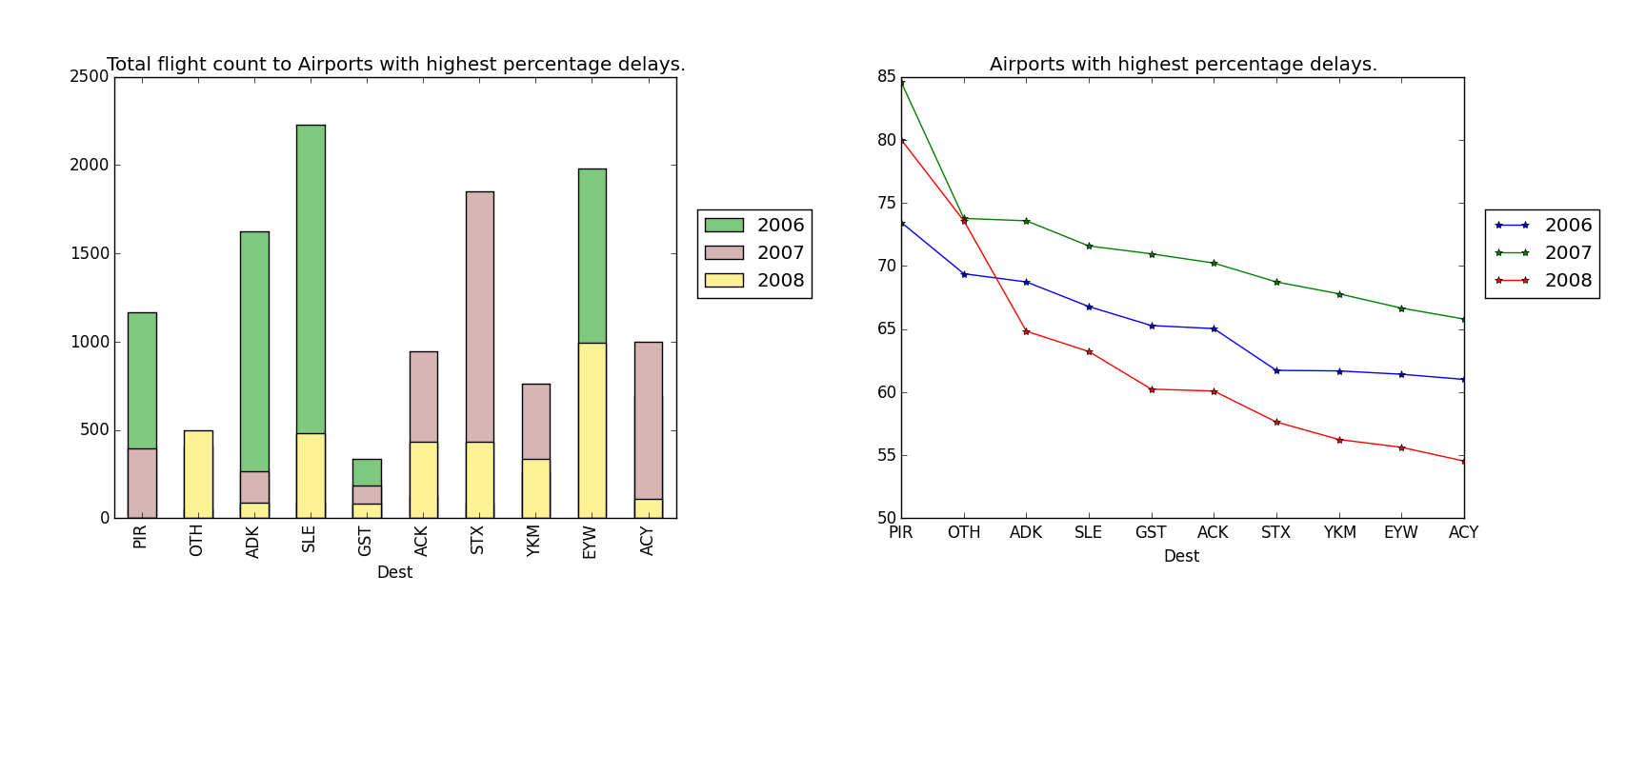
Airports based:
Trend shows that most of the small airports like Pierre, SD (PIR) have a high percentage of delayed incoming flights.

Slide 7
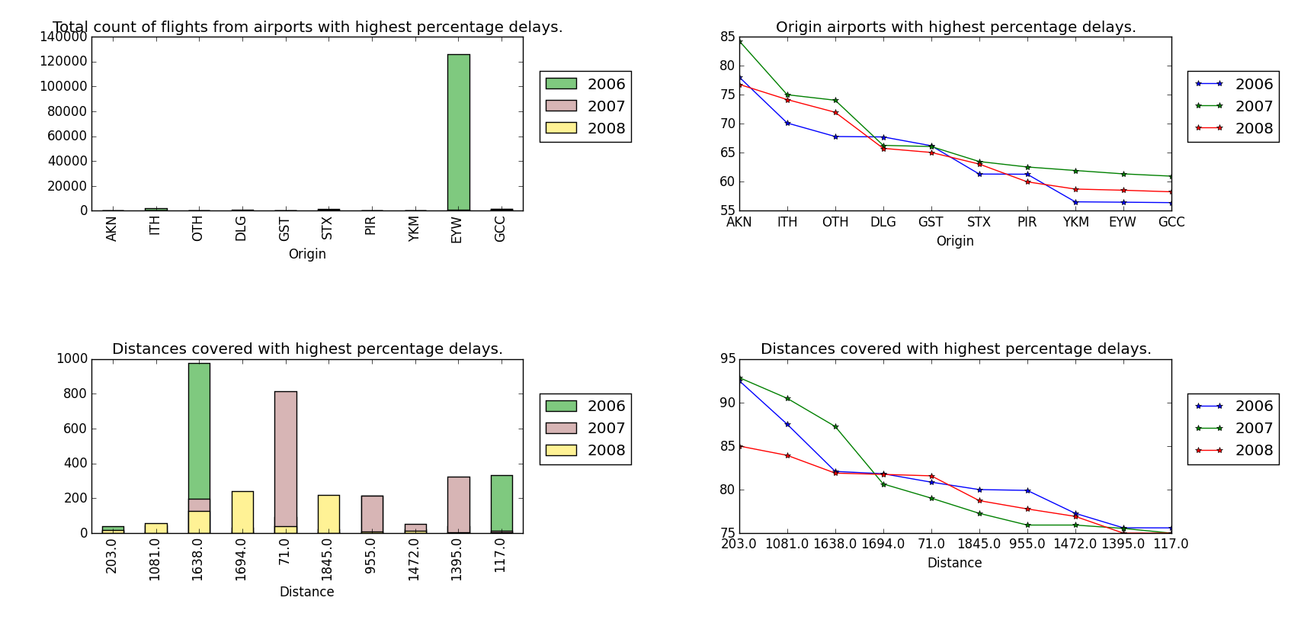
Airports based cont.:
When we analyze airports from where flights departed and arrived late at other airports, we can see some repeated names like Pierre, SD (PIR) which we know we should definitely avoid to dodge delays. However, there is a mix of short and long distances having high rate of delays, which means not all short-distance flights are likely to have delays and the same is true for long-distance flights.

Slide 8

Conclusion:
Airline delays are not always caused by weather alone.
We can be prepared to face delays or avoid them by:
booking in the months of January, March, April, May, September, October, November.
Booking between Saturday and Wednesday to avoid delays.
Avoiding certain airports, like (OTH) North Bend, OR, (GST) Gustavus, AK, (PIR) Pierre, SD, (YKM) Yakima, WA and (EYW) Key West, FL which have flights arriving late and have flights departing from there arriving late at other places more often
Knowing certain airlines tend to have more delays.

Slide 9
References
DataSources:
http://www.transtats.bts.gov/DL_SelectFields.asp?Table_ID=236&DB_Short_Name=On-Time
http://stat-computing.org/dataexpo/2009/carriers.csv
http://stat-computing.org/dataexpo/2009/airports.csv
Images:
https://pixabay.com/en/airplane-silhouette-clip-aircraft-872479/
https://pixabay.com/en/problem-question-mark-question-1020300/
https://pixabay.com/en/problem-analysis-mark-marker-hand-663333/
https://pixabay.com/en/idea-response-enlightenment-wisdom-1020068/

